Slide 1

Concept Draft - TOONS
Oliver Lewis – U1961638

Slide 2

Contents
Mood board
2-column script
storyboard
Style frames

Slide 3

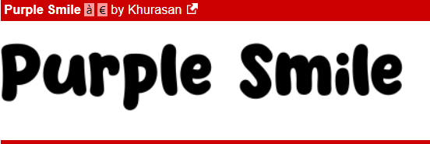

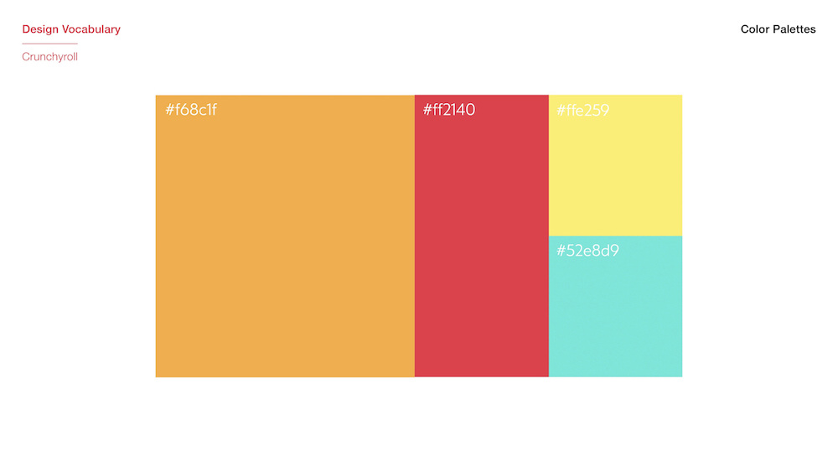
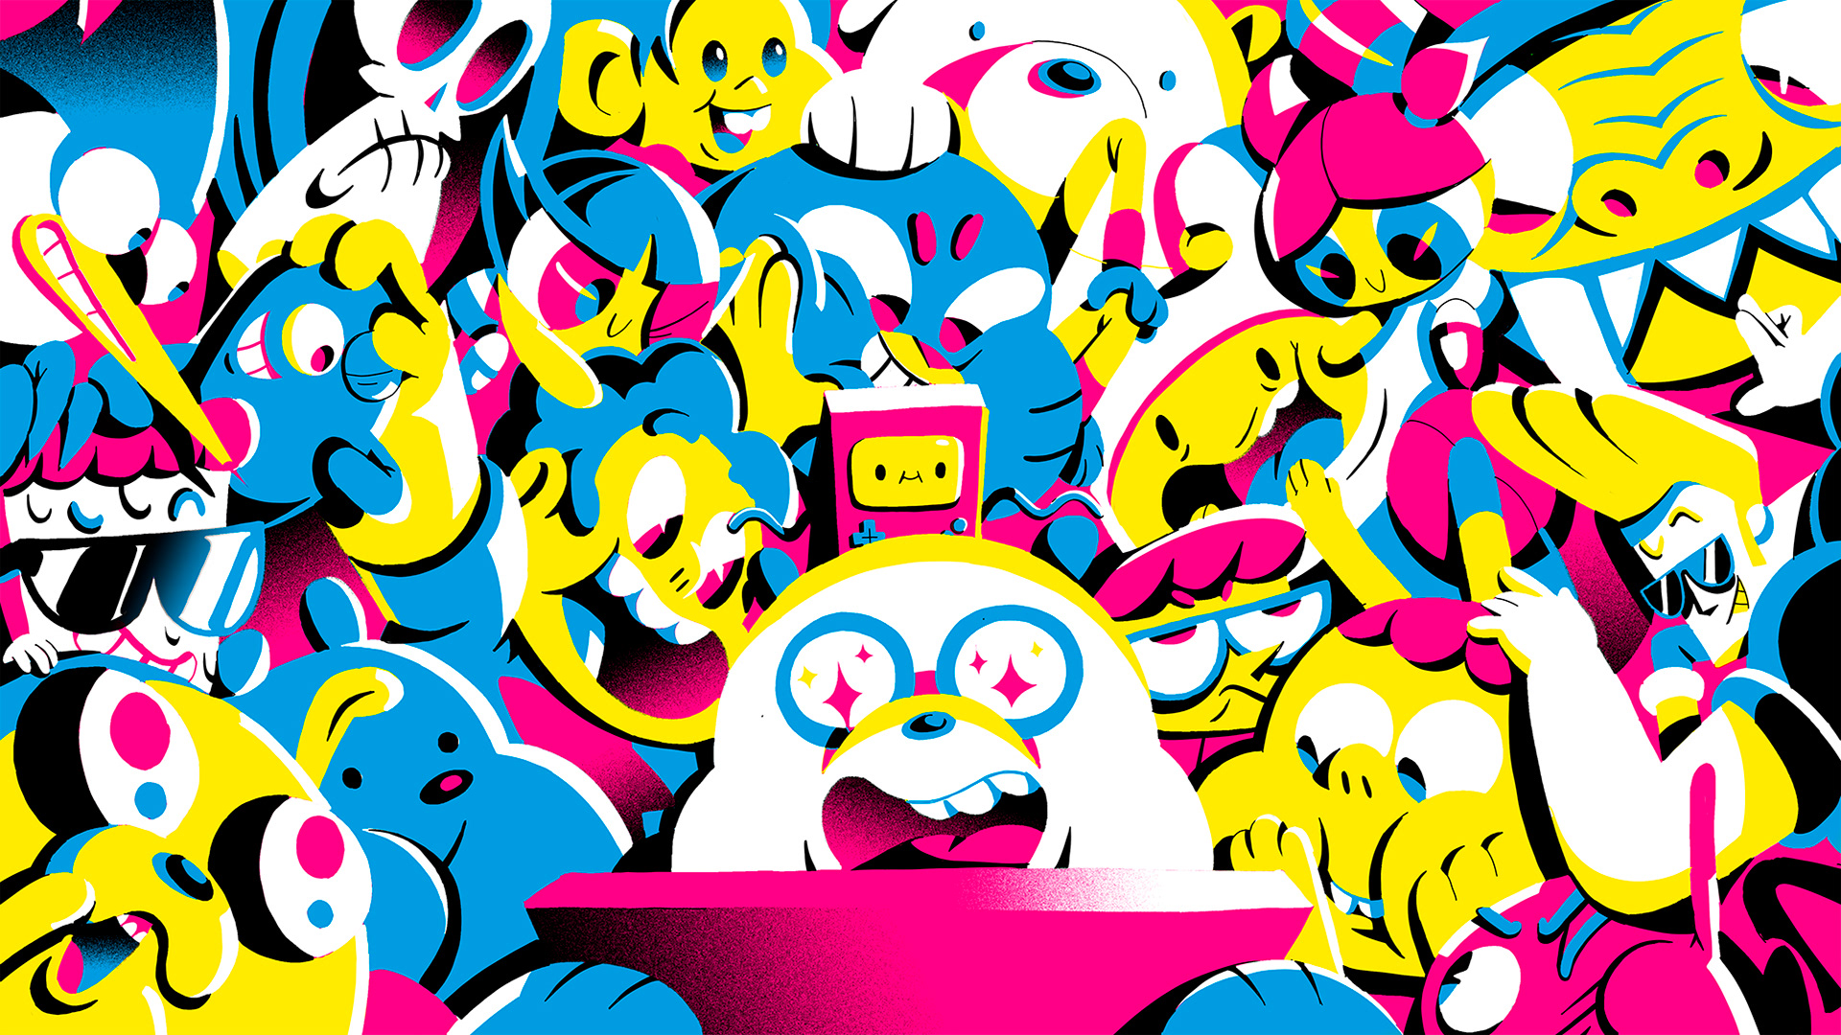

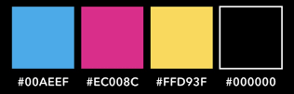
Mood Board

Slide 4
Script
Text/Audio | Action/Description
Scene 1: Audio voice over - Bored of your regular rundown streaming service? | User/customer with a bored expression sitting watching television while camera lowers bringing them into view.
Scene 2: Audio - Up-beat music begins to play Voice over - Imagine if you could stream your favourite cartoons and music on one service | Change in emotional tone, characters expression increases to a smile as colour returns to the screen, slow zoom towards character and tv.
Scene 3: Text – “Do not attempt to adjust your television” Audio - Up-beat music continues | Change to characters point of view, looking towards the television as regular broadcast is taken over, via text appearing on the screen.
Scene 4: Text – “stay tooned” Audio - Up-beat music continues | Animated text flies in from the left and then the right telling the user to stay tuned for the advertisement they're about to be shown.
Scene 5: Audio - Up-beat music continues | Radial animation expands outwards from the television screen slowly engulfing the view of the camera.
Scene 6: Text – “Cartoons, sound tracks, theme songs, AMV’s, Music & Music videos” | Animated text drops down in order on the screen, listing the various features of that the streaming services will offer.
Text/Audio | Action/Description
Scene 7: Audio - Up-beat music continues | Transitional scene of radial circle shape animation receding inwards from previous scene.
Scene 8: Audio - Up-beat music continues | Users hand holding phone slides on screen from the left side, giving a close up of the mobile app in use.
Scene 9: Audio - Up-beat music continues | Point of view of user interaction with mobile phone, repeater animation exploding from phone when user presses buttons.
Scene 10: Audio - Up-beat music continues | Snap zoom towards mobile phone showcasing app features after user interacts with the app, zoom timed with interaction.
Scene 11: Audio - Up-beat music continues | Another radial animated transition scene, starting small in the centre of the screen extending outwards.
Scene 12: Text – “Toons” Audio - Up-beat music continues | Toons logo drops down from above the screen, while a hand holding a phone presenting the mobile app towards the camera, with animations in the background and overlayed.

Slide 5
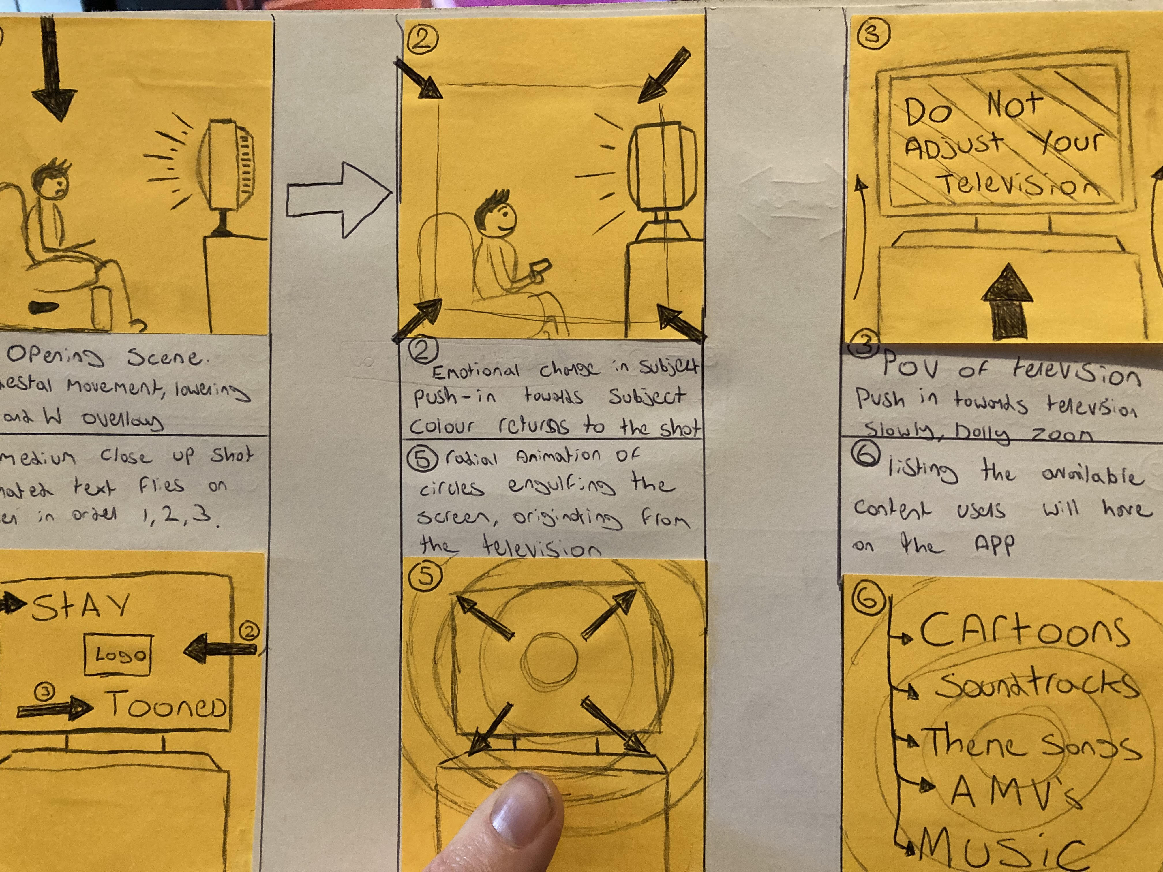
Storyboard
Scene: 1 - 6

Slide 6
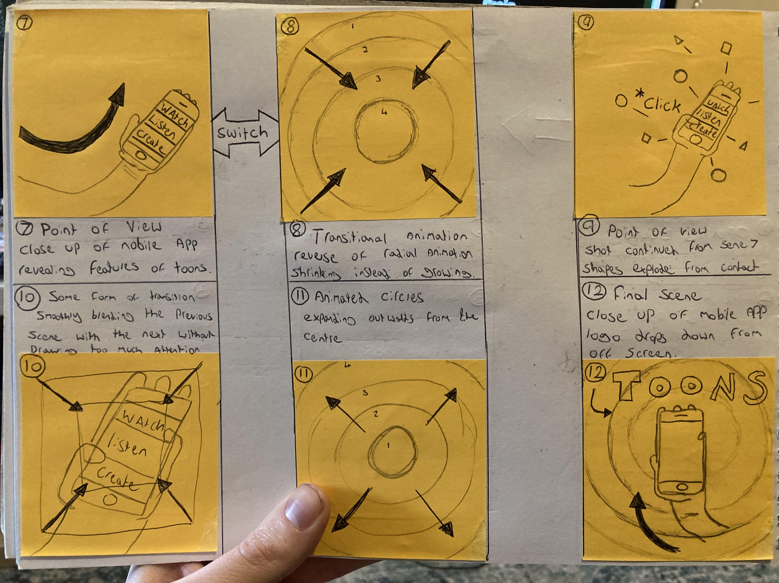
Storyboard
Scene: 7 - 12

Slide 7
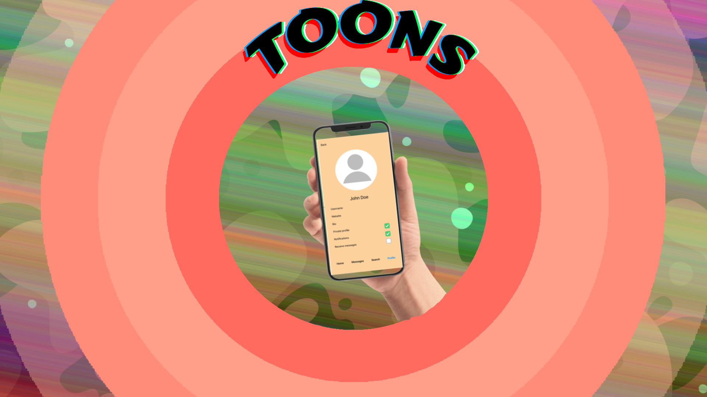
Style Frame

